Slide 1
Epi Recipes Visualization Application

Slide 2
Discovering Data Driven Insights

Slide 3
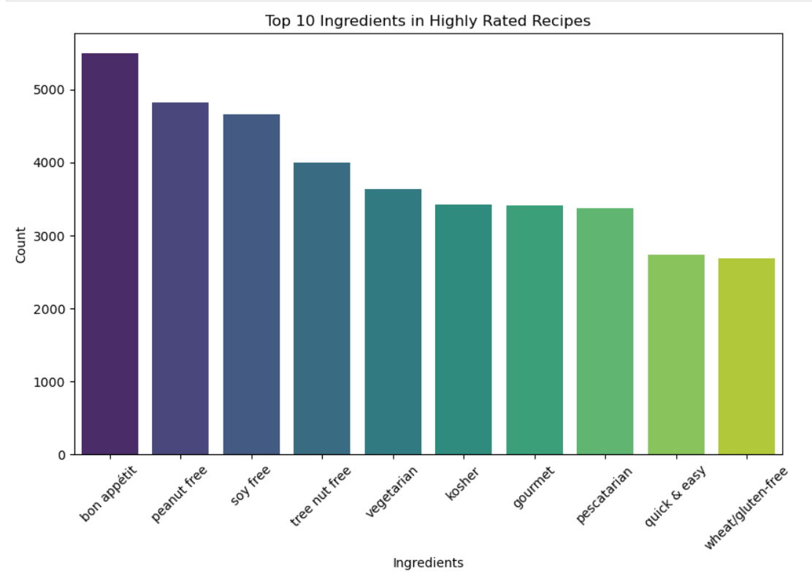
BAR CHART- Top 10 Ingredients in Highly Rated Recipes
Chart Type:
Bar Chart
Metrics:
Ingredients (x-axis), Count (y-axis)
Highlights:
"Bon appétit" is the most common, followed by "peanut-free" and "soy-free".
Insights:
Recipes with dietary restrictions (e.g., peanut-free) are highly rated.

Slide 4
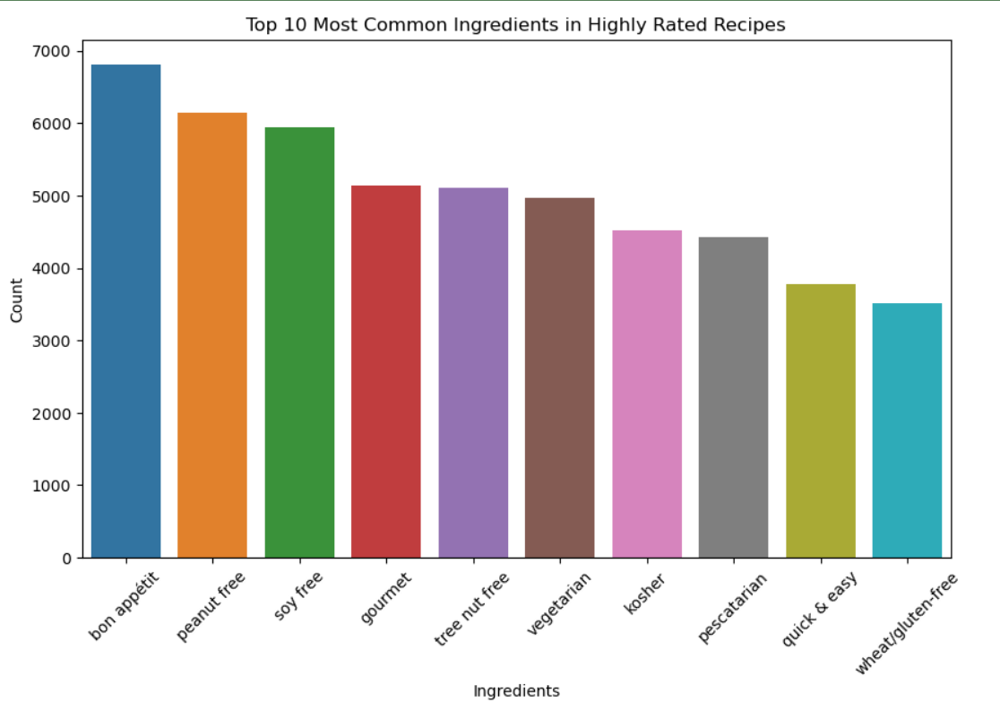
BAR CHART– Top 10 Ingredients in Highly Rated Recipes
Chart Type:
Bar Chart
Metrics:
Ingredients (x-axis), Count (y-axis)
Highlights:
"Bon appétit", "peanut-free", and "soy- free" are again the most frequent.
Insights:
Dietary-specific ingredients are consistently popular in highly rated recipes.

Slide 5
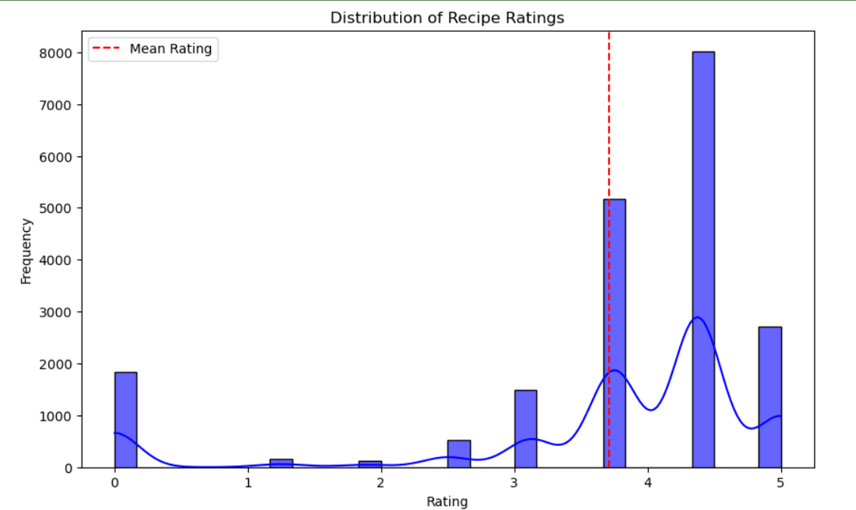
HISTOGRAM-Distribution of Recipe Ratings
Chart Type:
Histogram
Metrics:
Ratings (x-axis), Frequency (y-axis)
Highlights:
Most ratings cluster between 4 and 5, peaking at 5.
Mean rating (red dashed line) is just above 4.
Insights:
Recipes are generally well-received, with a strong bias toward high ratings.

Slide 6
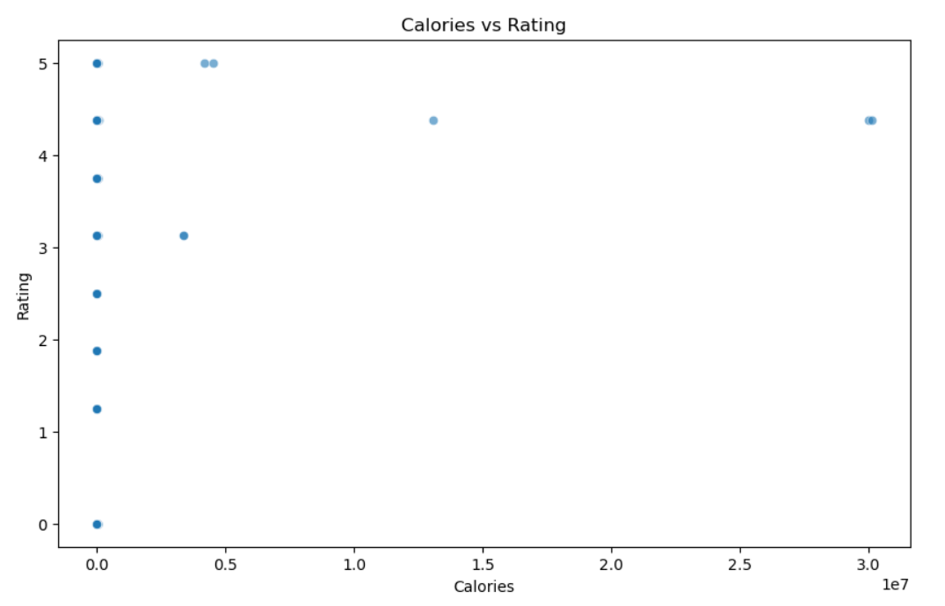
SCATTER PLOT(Calories vs Rating)
Chart Type:
Scatter Plot
Metrics:
Calories (x-axis), Ratings (y-axis)
Highlights:
Recipes cluster at low calorie counts with varying ratings.
One outlier with high calories.
Insights:
No clear correlation between calories and rating.

Slide 7
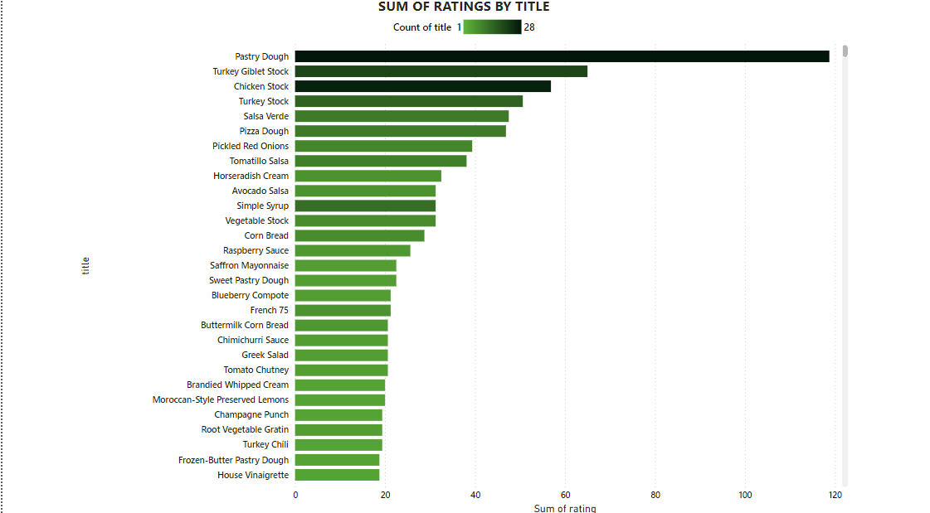
BAR CHART (Sum of Ratings by Title)
Chart Type:
Horizontal Bar
Metrics:
Sum of ratings (x-axis), Recipe titles (y-axis)
Highlights:
"Pastry Dough" has the highest rating.
Other top-rated recipes include "Turkey Giblet Stock" and "Salsa Verde."
Insights:
Users prefer versatile, foundational recipes like stocks and dough.

Slide 8
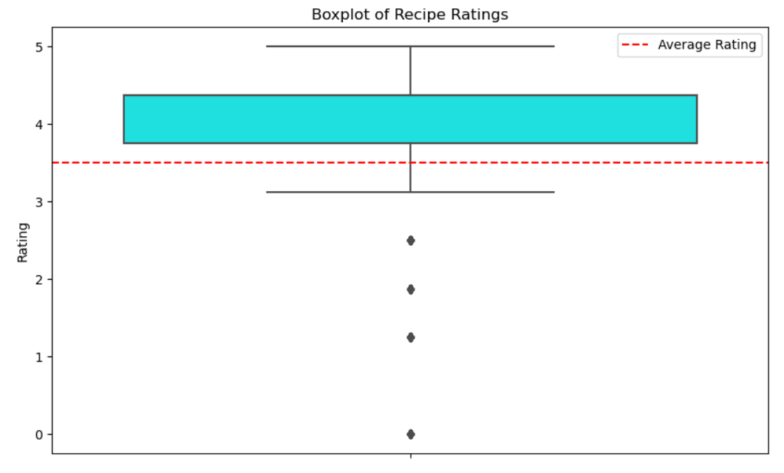
BOX PLOT – Distribution of Recipe Ratings
Chart Type:
Box Plot
Metrics:
Recipe Ratings (y-axis)
Highlights:
Most ratings are between 4-5, with a few outliers.
Insights:
Recipes generally receive high ratings, with few poorly rated ones.

Slide 9
Thanks
nichunadha8@gmail.com
91 8157097574
https://www.linkedin.com/in/nadha-pt-a0311b268

